Slide 1

Gifted &Talented 5

Slide 2
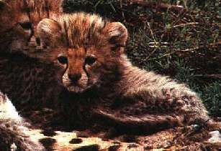
By Stephanie S. Tolan

Slide 3
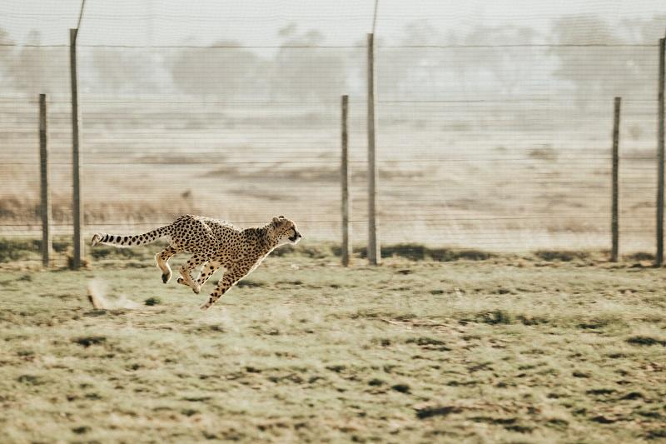

Slide 4


Slide 5
A bright child | A gifted child
Is attentive | Is mentally and physically involved
Has good ideas | Has wild, silly ideas
Works hard | Plays around, yet tests well
Answers the questions | Discusses in detail, elaborates
Top Group | Beyond the group
Listens with interest | Shows strong feelings and opinions
Learns with ease | Already knows
6-8 repetitions for mastery | 1-2 repetitions for mastery
Understands ideas | Constructs abstractions
Enjoys peers | Prefers adults or older children instead of same age peers
Grasps the meaning | Draws inferences and opens up new questions
Completes assignments | Initiates projects
Is receptive | Is intense
Copies accurately | Creates a new design
Enjoys school | Enjoys learning - but may hate school.
Absorbs information | Manipulates information
Technician | Inventor - Loves construction toys
Good Memorizer | Good guesser - draws on vast information store.
Is alert | Is keenly observant - seems to remember fine details
Is pleased with own learning | Is highly self-critical - can be perfectionistic to the point of tantrums
Enjoys straight-forward, sequential presentation | Thrives on complexity - needs the whole picture
  To

Slide 6
Gifted | ADD/ADHD
Contact with intellectual peers diminishes inappropriate behavior | Contact with intellectual peers has no positive effect on behavior
Appropriate academic placement diminishes inappropriate behavior | Appropriate academic placement has no positive effect on behavior
Curricular modifications diminish inappropriate behaviors | Curricular modifications have no effect on behavior
The child has logical (to the child) explanations for inappropriate behavior | Child cannot explain inappropriate behavior
When active, child enjoys the movement and does not feel out of control | Child feels out of control
Learning appropriate social skills had decreased "impulsive" or inappropriate behavior | Learning appropriate social skill has not decreased "impulsive" or inappropriate behavior
Child has logical (to the child) explanations why tasks, activities are not completed | Child is unable to explain why tasks, activities are not completed
Child displays fewer inappropriate behaviors when interested in subject matter or project | Child's behaviors not influenced by his/her interest in the activity
Child displays fewer inappropriate behaviors when subjuect matter or project seems relevant or meaningful to the child | Child's behaviors do not diminish when subject matter or project seems relevant or meaningful to the child
Child attributes excessive talking or interruptions or need to share information, need to show that he/she knows the answer, or need to solve a problem immediately | Child cannot attribute excessive talking or interruptions to a need to learn or share information
Child who seems inattentive can repeat instructions | Child who seems inattecitve is unable to repeat instructions
Child thrives on working on multiple tasks-- gets more done, enjoys learning more | Child moves from task to task for no apparent reason
Inappropriate behaviors are not persistent-- seem to be a function of subject matter | Inappropriate behaviors persist regardless of subject matter
Inappropriate behaviors are not persistent-- seem to be a function of teacher or instructional style | Inappropriate behaviors persist regardless of teacher or instructional style
Child acts out to get teacher attention | Child acts out regardless of attentio

Slide 7
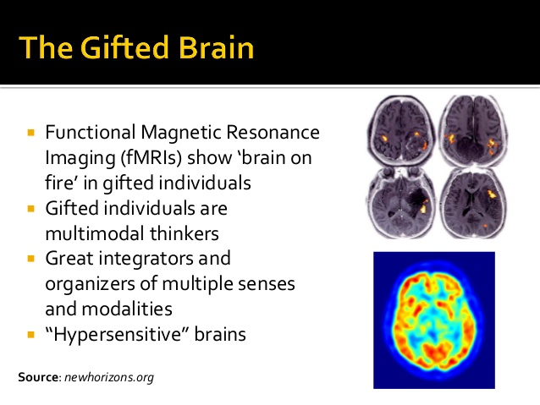
A different brain
Has more volume of grey matters (in the frontal cortex )
H compute information better & faster
make faster decisions
process & hold more information

Slide 8
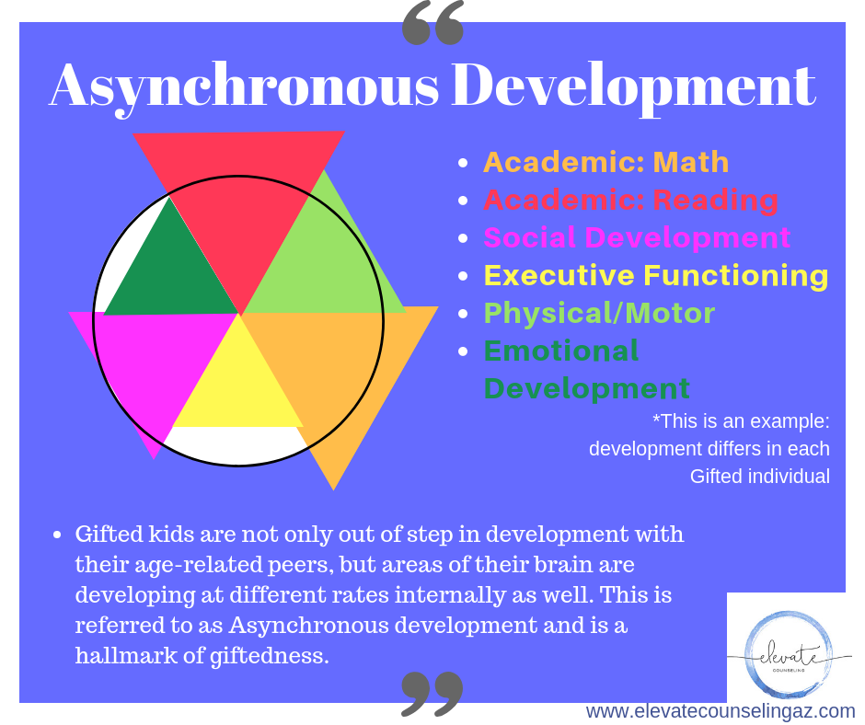

Slide 9
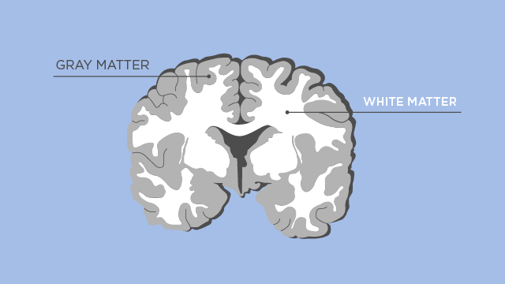

Slide 10
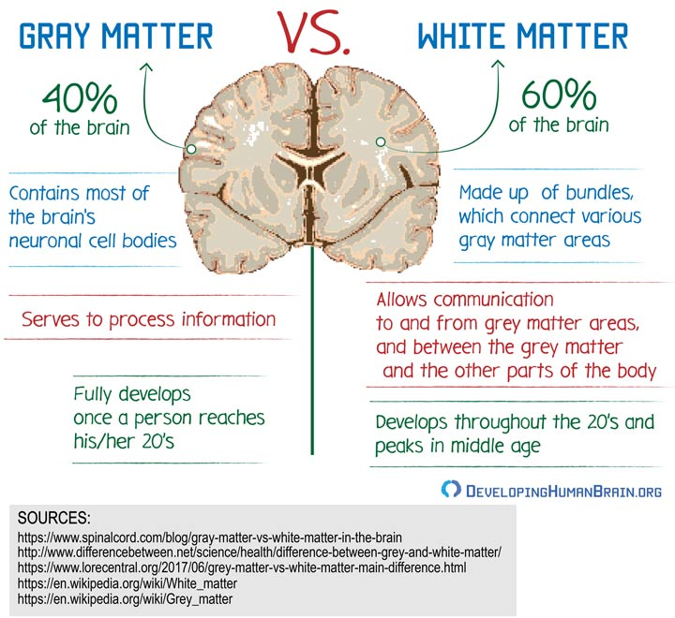

Slide 11
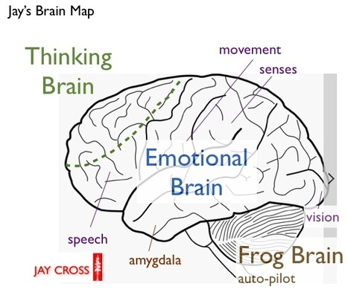

Slide 12
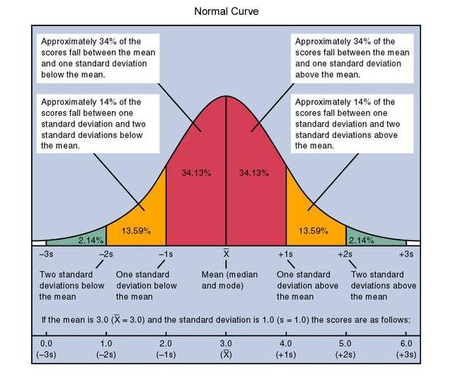

Slide 13
資優新概念 Joseph Renzulli
3 ring model
中上智能
創造力
對某學問有工作的熱衷

Slide 14
Two Types of Giftedness
Schoolhouse or Lesson Learning Giftedness
Creative/Productive Giftedness

Slide 15
Overexcitability & the Gifted
“…not all gifted or highly gifted individuals have overexcitabilities. However we do find more people with OEs in the gifted population than in the average population…”
Kazimierz Dabrowski, (1902-1980)

Slide 16
5 areas of intensity
Psychomotor
Sensual
Intellectual
Imaginational
Emotional
A gifted person may possess one or more of these

Slide 17

1. PSYCHOMOTOR OVEREXCITABILITY
Heightened excitability of the neuromuscular system:
capacity for being active and energetic
love of movement
surplus of energy
rapid speech
enthusiastic
a need for action
talk compulsively
act impulsively
misbehave and act out
display nervous habits
workaholism
competitive

Slide 18
PSYCHOMOTOR STRATEGIES
allow time for physical or verbal activity because they love to “do” and need to “do.”
build activity and movement into their lives
provide time for spontaneous and open-ended activities

Slide 19
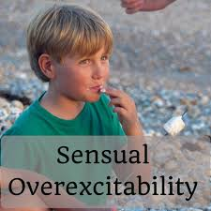
2. SENSUAL OVEREXCITABILITY
Heightened experience of sensual pleasure or displeasure from sight, smell, touch, taste, and hearing
Increased, early appreciation of aesthetic pleasures (music, language, art)
Derive endless delight from tastes, smells, textures, sounds, and sights
Feel over stimulated or uncomfortable with sensory input - find clothing tags, classroom noise, or smells distracting
May become absorbed in their love of a particular piece of art or music
May overeat, over-buy
Seek the physical sensation of being the center of attraction

Slide 20
SENSUAL STRATEGIES
Create an environment which limits offensive stimuli and provides comfort
Provide appropriate chances for them to show their abilities by giving unexpected attention
Facilitate creative and dramatic productions with an audience so they can gain
positive attention
4. Create a soothing and comfortable environment

Slide 21
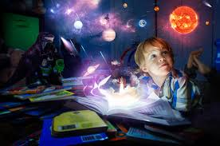
3. INTELLECTUAL OVEREXCITABILITY
seek understanding and truth, to gain knowledge, to analyze and synthesize
intensely curious
avid readers
keen observers
able to concentrate
engage in prolonged intellectual effort
problem solver
have remarkably detailed visual recall
love theory
thinking about thinking
moral thinking - concerns about moral and ethical issues-fairness
concerned about “adult” issues such as the homeless, environment or war
critical of and impatient with others who cannot sustain their intellectual pace
become excited about an idea may interrupt at inappropriate times

Slide 22
INTELLECTUAL STRATEGIES
Encourage them to act upon their concerns-such as collecting blankets for the homeless or to protect environment
If being too critical or outspoken to others, help them to see how their intent may be perceived as cruel or disrespectful

Slide 23

4. IMAGINATIONAL OVEREXCITABILITY
imaginative - rich association of images and impressions
frequent use of image and metaphor, detailed visualization, and elaborate dreams
mix truth with fiction, or create their own private worlds with imaginary friends
find it difficult to stay tuned into a classroom
write stories or draw instead of doing seatwork or participating in class discussions
have difficulty completing tasks when they drift off into their imagination

Slide 24
IMAGINATIONAL STRATEGIES
help them differentiate between their imagination and the real world by having them place a stop sign in their mental videotape, or write down or draw the factual account before they embellish it
help them use their imagination to function in the real world and promote learning and productivity

Slide 25

5. EMOTIONAL OVEREXCITABILITY
heightened, intense feelings, extremes of complex emotions, identification with others’ feelings, and strong affective expression
May have physical responses like stomachaches and blushing or concern with death and depression
have a remarkable capacity for deep relationships
they show strong emotional attachments to people, places, and things
have compassion, empathy, and sensitivity in relation-ships
acutely aware of their own feelings and practice self-judgment
“overreacting.” intensity of their feelings may interfere with everyday tasks

Slide 26
EMOTIONAL STRATEGIES
accept all feelings, regardless of intensity
teach individuals to anticipate physical and emotional responses and prepare for them
help them identify the physical warning signs of their emotional stress such as headache, sweaty palms, and stomachache so that they can cope with emotional situations and not lose control

Slide 27
Conclusion
Discuss the concept of overexcitability
Focus on the positives
Provide chances for them to pursue their passions
Show respect for their abilities and intensities
Allow time for them to commit in what they love
Don’t remove passions as consequences for wrong behaviours
Teach communication skills
Provide safe places for them to work or think which are not distracting
10. Help to raise awareness of how their behaviours many impact
on others
11. Teach stress management

Slide 28


Slide 29
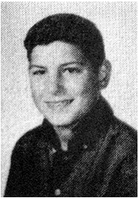
This young man really dislikes school and finds it too strict. . He continuously gets suspended for mischievous deeds. For instance, He and his friend changed the combinations of everyone’s bike locks and set off explosives in teacher's desks.

Slide 30
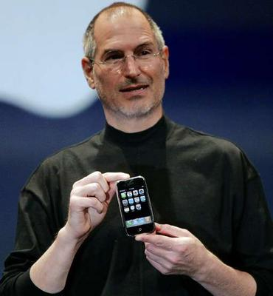
Notes:
Jobs was a quintessential Silicon Valley hero, following on from HP's Bill Hewlett and David Packard and preceding Google's Larry Page and Sergey Brin. He built one of the world's richest and most successful corporations against all the odds, using his own taste, talents and willpower. He was, of course, in the right place at the right time – the start of the personal computer industry – and he was well placed to catch the wave as analogue industries changed from vinyl, tapes, film, paper and other physical formats to digital ones. But Jobs was unique in his ability to ride that wave, and shape it in ways that no rival could emulate.
Jobs is survived by his wife, Laurene Powell, whom he married in a Buddhist ceremony in 1991, and their children, Reed, Erin and Eve; by Lisa; and by a sister, the novelist Mona Simpson.
• Steven Paul Jobs, businessman, born 24 February 1955; died 5 October 2011
larger | smaller
Technology
Steve Jobs ·
Computing ·
Apple
World news
United States
More obituaries
More on Steve Jobs
Steve Jobs honoured by Silicon Valley
Executives gather at Stanford University to celebrate life of Apple founder, who died of pancreatic cancer recently
Steve Jobs wasn't a god, but let's give him his due
Steve Jobs: the movie
Seven lessons from Apple's founder
How Steve Jobs made the world more beautiful
Steve Jobs: the 10 best tributes
How Steve Jobs changed capitalism
Eyewitness: A shrine to Steve Jobs
Steve Jobs, Apple co-founder, dies
Steve Jobs: Stanford commencement address, June 2005
Steve Jobs died of respiratory arrest, death certificate reveals
Steve Jobs biography to be released on 24 October
Tributes: the world remembers his genius
Rise of a pioneer: from parents' garage to world power
The life and career of Apple's driving force
Steve Jobs quotes: the man in his own words
The day Steve Jobs crowned me king of the fanboys
Steve Jobs: the world pays tribute
Steve Jobs: think different
Steve Jobs authorised biography tops bestseller list on pre-orders
Related
6 Oct 2011
Steve Jobs: from parents' garage to world power
6 Oct 2011
Steve Jobs quotes: the man in his own words
6 Oct 2011
Steve Jobs tributes outside Apple's HQ - video
25 Aug 2011
Steve Jobs resigns as Apple CEO
Printable version
Send to a friend
Share
Clip
Contact us
Article history
Ads by Google
Become a Life Coach
Begin with 5hrs Free Video Access! Anthony Robbins & Cloe Madanes.
RobbinsMadanesTraining.com
Pay-Per-Click Advertising
Reach Your Customers With Google. Get Your Ad Online In Just 15 Mins!
www.Google.com/AdWords
Brain Training Games
Improve memory with scientifically designed brain exercises.
www.lumosity.com
<div style="display: none" id="__document_write_ajax_div-7"></div><SCRIPT language='JavaScript1.1' >window['__document_write_ajax_callbacks__']['7']();</script> <NOSCRIPT> <A HREF="http://ad-emea.doubleclick.net/jump/N2581.133705.GUARDIAN.CO.UK/B6119158.3;abr=!ie4;abr=!ie5;sz=160x600;click0=http://oas.guardian.co.uk/5c/www.guardian.co.uk/technology/2011/oct/06/steve-jobs-obituary/oas.html/L29/1737256903/Right1/Guardian/NYTimesPaywall_JAN12_US_SKY_RON/NYTimesPaywall_US_SKY_RON.html/51507877326b3863505055414330784a?;ord=1737256903?"> <IMG SRC="http://ad-emea.doubleclick.net/ad/N2581.133705.GUARDIAN.CO.UK/B6119158.3;abr=!ie4;abr=!ie5;sz=160x600;click0=http://oas.guardian.co.uk/5c/www.guardian.co.uk/technology/2011/oct/06/steve-jobs-obituary/oas.html/L29/1737256903/Right1/Guardian/NYTimesPaywall_JAN12_US_SKY_RON/NYTimesPaywall_US_SKY_RON.html/51507877326b3863505055414330784a?;ord=1737256903?" BORDER=0 WIDTH=160 HEIGHT=600 ALT="Advertisement"></A> </NOSCRIPT> "
Guardian Government Computing
Westminster council leads £1.2bn tri-borough back office deal
Local authority leads procurement for four-year framework agreement covering HR, business intelligence and disaster recovery
1 comment
Guardian Government Computing
DWP hands £316m Desktop 21 deal to HP
Incumbent wins contract to provide Department for Work and Pensions' desktop management
Post your comment
More from our Government Computing Network
On Technology
Most viewed
Zeitgeist
Latest
Last 24 hours
1. Rick Falkvinge: the Swedish radical leading the fight over web freedoms
2. Q&A: Stop Online Piracy Act (SOPA)
3. Could Kodak's demise have been averted?
4. Megaupload shutdown: guns, cars and cash seized in police swoop
5. The top 50 iPad apps
More most viewed
This week's bestsellers
1. Alan Turing by Andrew Hodges £10.99
2. AQA Computing AS by Sylvia Langfield £18.99
3. iPad for the Older and Wiser by Sean McManus £12.99
4. Discovering Statistics Using SPSS by Andy Field £39.99
5. Photographer's Eye by Michael Freeman £17.99
Search the Guardian bookshop
Bestsellers from the Guardian shop
Steepletone Memphis music centre
Play your cherished vinyl, tapes and CDs or transfer them to digital format for just £149.95.
From: £7.95
Shop more reader offers
See all offers and services from the Guardian
Find the latest jobs in your sector:
Arts & heritage
Charities
Education
Environment
Government
Graduate
Health
Marketing & PR
Media
Sales
Senior executive
Social care
Browse all jobs
iOS Software Developer
London | Competitive
GUARDIAN NEWS AND MEDIA
Related information
Technology
Steve Jobs ·
Computing ·
Apple
World news
United States
Steve Jobs – what next for Apple?
17 Jan 2011
Apple shares have dipped after the firm's co-founder announced he is to take an open-ended break on medical grounds. By Charles Arthur
6 Oct 2011
Steve Jobs: the world pays tribute
7 Oct 2011
Steve Jobs biography to be released on 24 October
6 Oct 2011
Steve Jobs: a man of contradiction and genius
6 Oct 2011
Apple co-founder Steve Jobs dies aged 56
Steve Jobs's last words: 'Oh wow. Oh wow. Oh wow'
31 Oct 2011
Mona Simpson, sister of the late Apple co-founder, reveals details of the final moments Jobs spent with his family
Steve Jobs obituary
Computing entrepreneur and inventor, and the co-founder, chairman and recognisable face of Apple
reddit this
Jack Schofield
guardian.co.uk, Wednesday 5 October 2011 20.07 EDT
Article history
Steve Jobs: his life and career. Credit: Charles Arthur and Richard Sprenger Link to this video Steve Jobs, who has died aged 56 of pancreatic cancer, made an unprecedented impact on the world's consumer electronics markets with a string of successful products, including the iPod media player, iPhone smartphone and iPad tablet computer. In little more than a decade, he took Apple – the company he co-founded in 1976, and returned to in 1997 – from near-bankruptcy to being the world's second most valuable company by market capitalisation, after the oil giant Exxon, with around $80bn in the bank.

Slide 31
Resources
https://www.davidsongifted.org/
http://www.hoagiesgifted.org/
https://www.sengifted.org/
https://www.davidsongifted.org/search-database/entry/a10226
http://gleigh.tripod.com/brightvG.htm
https://www.davidsongifted.org/search-database/entry/a10441
http://www.cw.bc.ca/library/pdf/pamphlets/Mighty%20Moe1.pdf
https://www.sengifted.org/post/overexcitability-and-the-gifted

